Slide 1

Introduction

Slide 2
Objectives
Describe the technologies involved in the creation of AI applications
Activate Trial Account (review)
AI Application- Introduction

Slide 3
AI Application Introduction
You'll learn how to create more useful and complex chatbots by integrating Watson Assistant with other services available in the IBM Cloud catalog
Develop a student advisor:
  not only responds to the user with preset answers
  But can use an existing knowledge base to fetch answers for the many possible questions students may have
AI Application- Introduction

Slide 4
AI Application Introduction
What is a student advisor chatbot?
  A student advisor chatbot can provide answers to most questions while still allowing escalation to a human customer care team.
  For more complex inquiries that require manual intervention or extra care, students might have questions about the platform itself and its usage.
Example:
  ask what's the difference between auditing a course and paying for it?
  ask which course should I take to learn about chatbots?
AI Application- Introduction

Slide 5
Technologies
Using Watson Assistant
The Watson Text-to-Speech APIs
The Speech-to-Text APIs
DB2, a database service that allows us to analyze and extract insight from data sources.
REST API
AI Application- Introduction

Slide 6
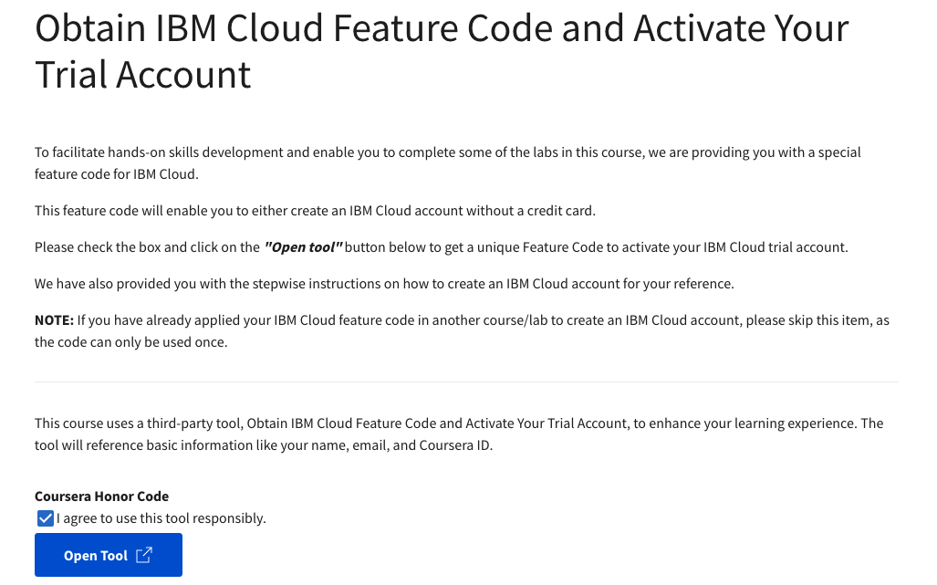
Active IBM Trial Account
jjjjjjj
AI Application- Introduction

Slide 7
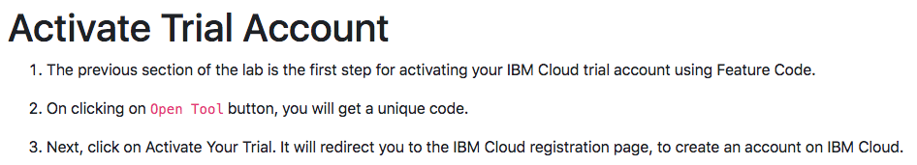
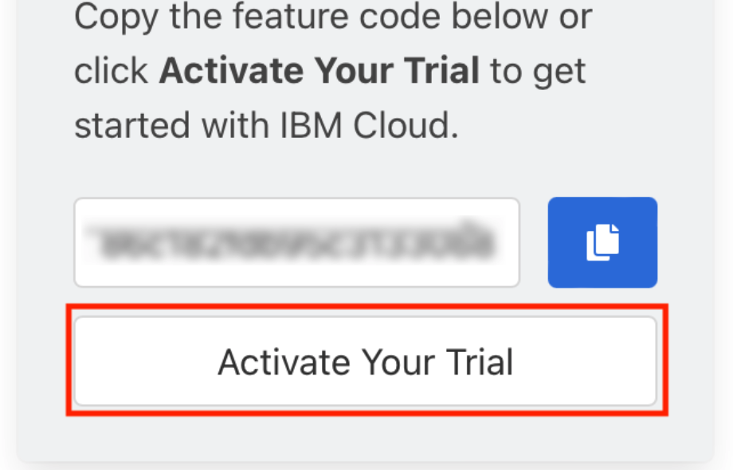
Active IBM Trial Account
AI Application- Introduction

Slide 8
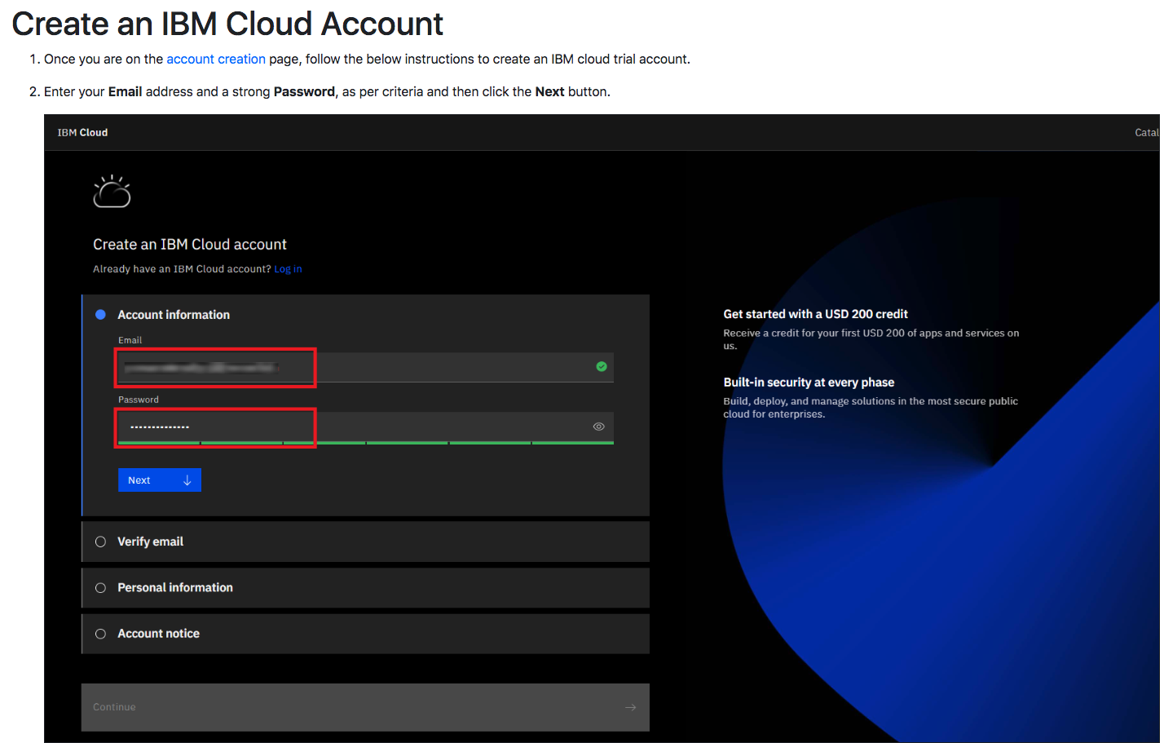
Active IBM Trial Account
AI Application- Introduction

Slide 9
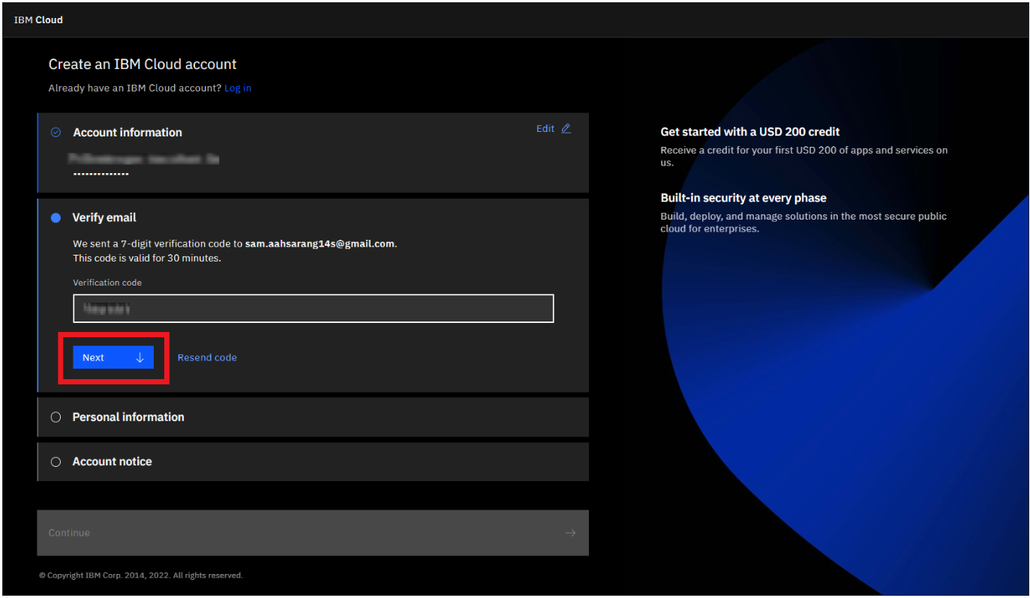
Active IBM Trial Account
AI Application- Introduction

Slide 10
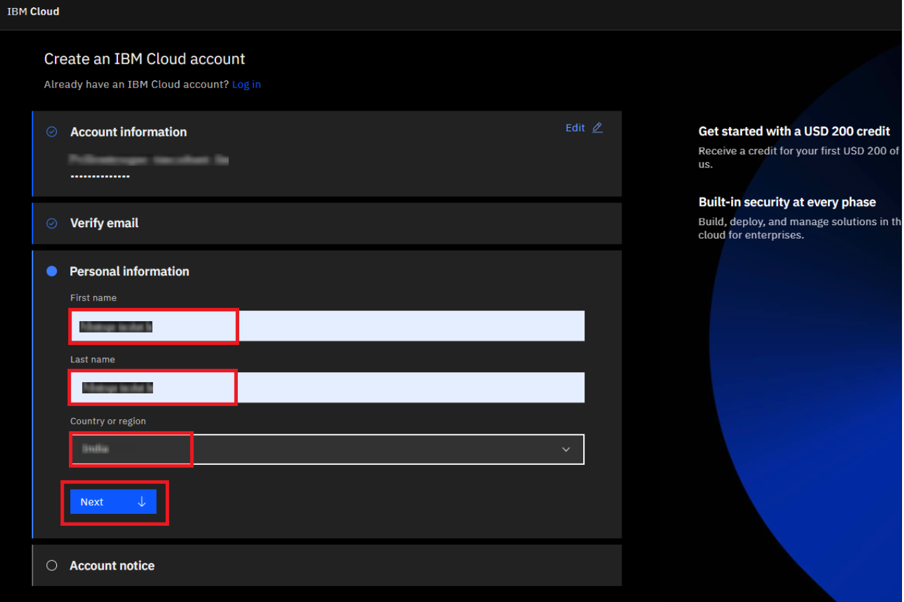
Active IBM Trial Account
AI Application- Introduction

Slide 11
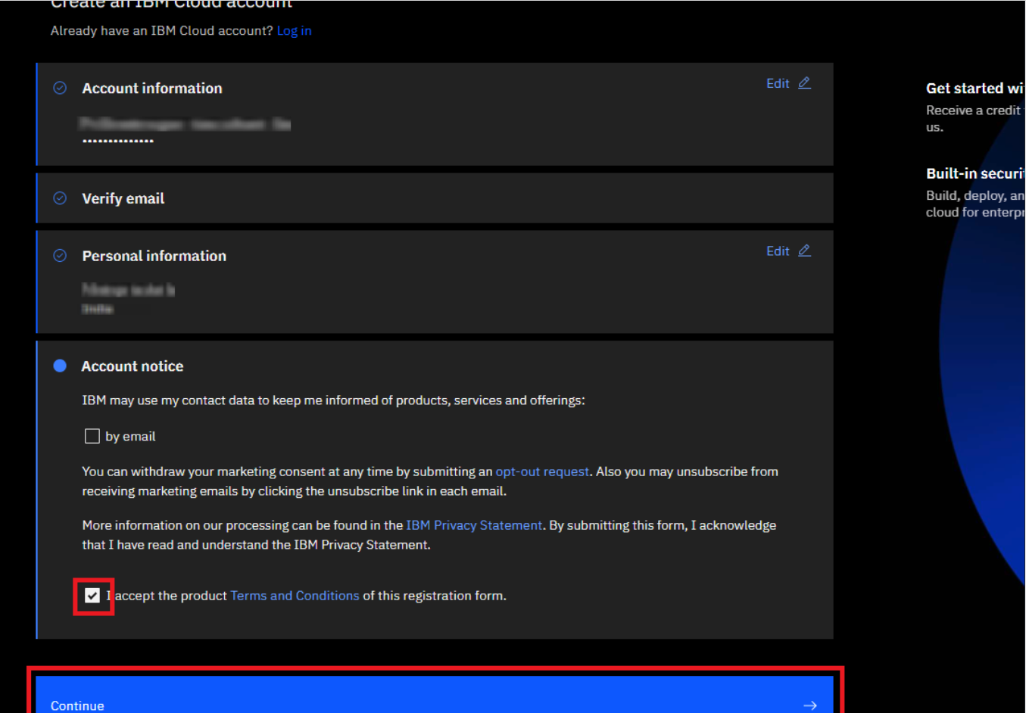
Active IBM Trial Account
AI Application- Introduction

Slide 12
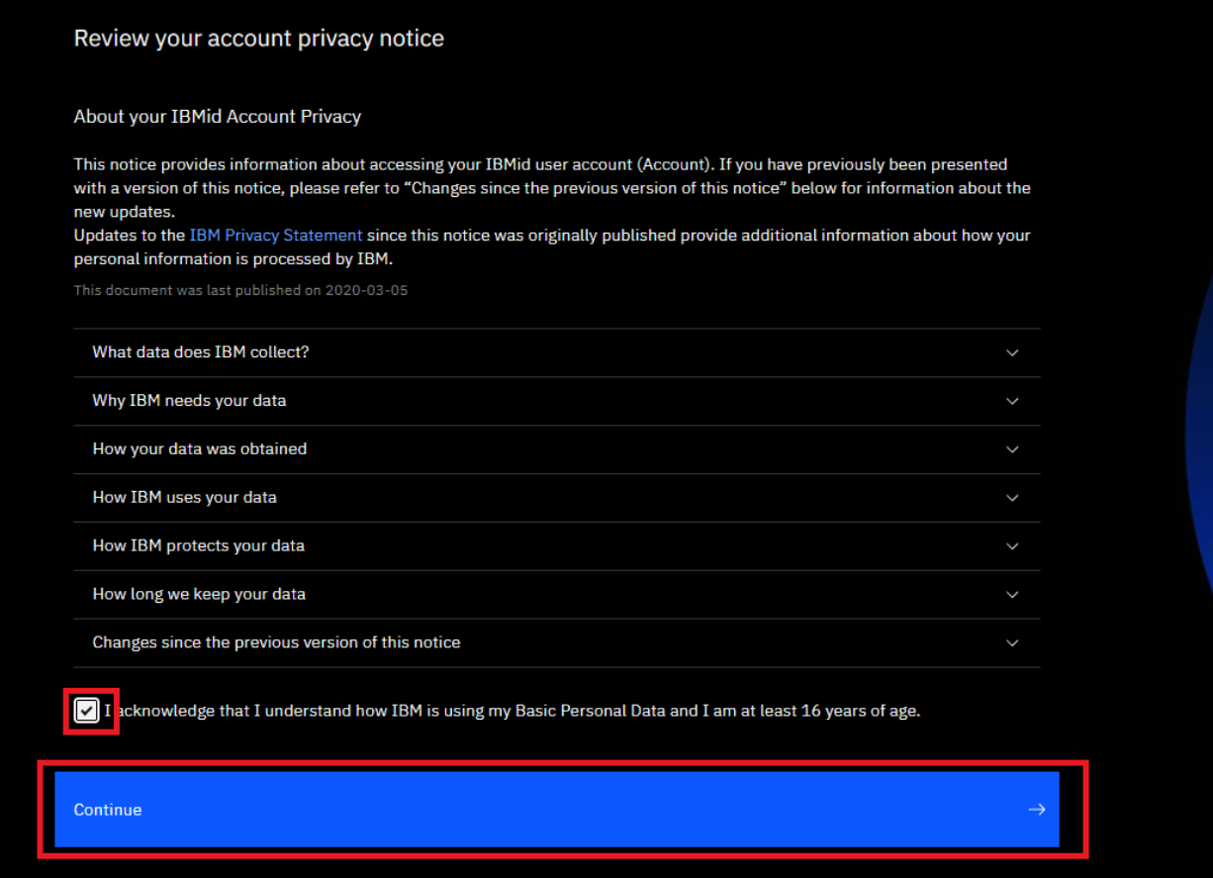
Active IBM Trial Account
AI Application- Introduction

Slide 13
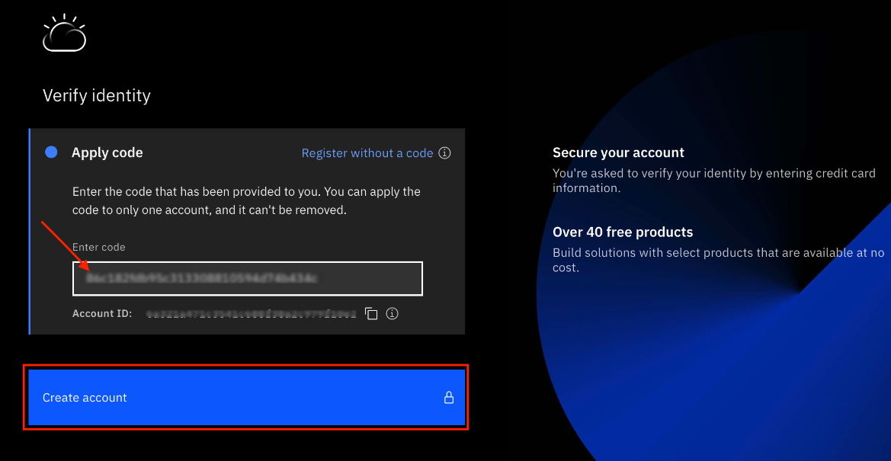
Active IBM Trial Account
AI Application- Introduction

Slide 14
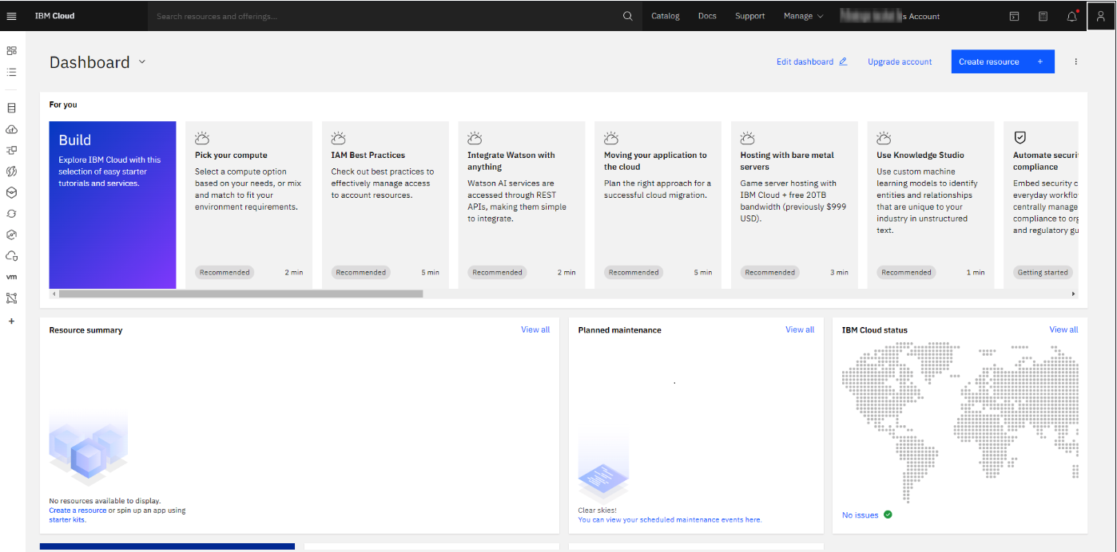
Active IBM Trial Account
AI Application- Introduction

Slide 15
Summary
Describe the technologies involved in the creation of AI applications
Activate Trial Account (review)
AI Application- Introduction

Slide 16
Q & A
AI Application- Introduction

